Slide 1
Chapter 9
Organizing your Speech

Slide 2
The Introduction
Have you ever heard the saying “Let a smile be your umbrella”? What about the observation “Laugh and the world laughs with you”? Both of these sayings deal with how a positive attitude and a sense of humor can make a bad situation a little bit better for both you and the people around you.
Notes:
Attention-getter: Interesting information might encourage an audience to listen

Slide 3
The Introduction
However, did you know that your ability to laugh can mean a great deal more than a pleasant smile or momentary delight? As a matter of fact, laughter can be very beneficial in many ways.
Notes:
Link - Clear connection is made between the introductory material and the speech topic

Slide 4
The Introduction
Consequently, I would like to discuss the various areas in your life where laughter can play a significantly positive role.
Notes:
Thesis Statement: Exactly what the speech is about

Slide 5
The Introduction
Let’s take a look at how laughter can help you on the job, with your friends and family, and with your health.
Notes:
Preview: Clear statement of the areas that the speech will discuss

Slide 6
Attention-Getters
First words you say to an audience must make them want to listen to you.
What works for you
What do you feel comfortable presenting

Slide 7
5 Types of Attention-Getters
Asking a Question
Making References
Making a Startling Statement
Giving a Quotation
Telling a Story (narrative)

Slide 8
Attention-Getters
Asking Questions
fires up audience curiosity; makes them active participants
Rhetorical
don’t really expect audience to answer, just gets them thinking

Slide 9
Attention-Getters
Example 1:
“The Power of Word Building”
verisimilitude
veracity
verity
truth
Notes:
How many of you know the meaning of 1?
What 2 means?
What about 3?
All 3 have something to do with truth.
I wouldn’t be telling you the truth if I didn’t confess that I had to look these words up in a dictionary. However, building vocabulary is a challenge that each of us should accept if . . .

Slide 10
Attention-Getters
Example 2:
“Shifting the Blame”
“The devil made me do it”
“Don’t blame me. It’s not my fault.”
Notes:
Have you ever heard someone say . . .
If you answered yes to one or both of these questions, then you would probably agree with me that many people in today’s society find it easy to make excuses and blame someone or something else for their problems. I would like to talk about . . .

Slide 11
Attention-Getters
Making References
Allows you to work with your audience
Refer to people in the audience, physical surroundings, other speakers, significance of the occasion
Allows you to be comfortable, congenial, and conversational
Provides speaker-audience unity

Slide 12
Attention-Getters
Example 1:
I see that John and Ina are in the audience. When we first started this class project over two months ago, they were the ones who provided the leadership and enthusiasm that the rest of us needed then. The word leadership is exactly what I wish to talk about tonight because . . .

Slide 13
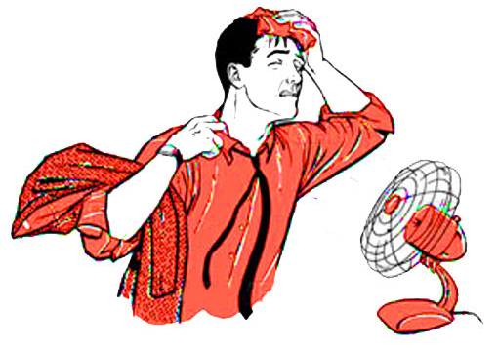
Attention-Getters
Example 2:
For some reason, every time that we are in this auditorium, the air-conditioning is out. Maybe we should all bring our own fans next time. However, the temperature might not be the only thing that is sticky tonight. My topic, “Why AIDS Needs to Be talked About in Schools,” could also make some people warm and uncomfortable. I have confidence, nevertheless, that if we work together . . .

Slide 14
Attention-Getters
Making a Startling Statement
jolts your audience into paying attention
statistics, surprising data, shocking numbers
be careful not to offend, wary of bad taste

Slide 15
Attention-Getters
Example 1:
I love music. I love dancing. I love how men and women, young and old, rich or poor, can move and smile and laugh and keep the rhythm to their favorite songs. However, today I’m n ot here to talk about music—because, ironically, every time that my hand comes down to “keep the beat,” a young child is physically or sexually abused in this country. And the violence is real . . .

Slide 16
Attention-Getters
Giving a Quotation
Add style and sophistication
Clear and appropriate for your topic
Include author and why noteworthy

Slide 17
Attention-Getters
Example 1:
“What Has Happened to Friendship?”
“First in was—first in peace—and first in the hearts of his countrymen.” These are the words that began Revolutionary War general Henry Lee’s famous funeral oration for George Washington. The quotation shows us a man of conscience and a man who cared for his fellow man. However, do we care for our fellow man today the same as Washington did in his day? I would like to take a look at . . .

Slide 18
Attention-Getters
Example 2 :
“Americans—Why Are We So Gullible?”
“You can fool all of the people some of the time and you can fool some of the people all of the time, but you can’t fool all of the people all of the time.” Abraham Lincoln, the author of this quotation, might have added the words “except in America,” because Americans are often easy prey for those wishing to make a fast buck. Let’s examine why Americans are so gullible and took a look . . .

Slide 19
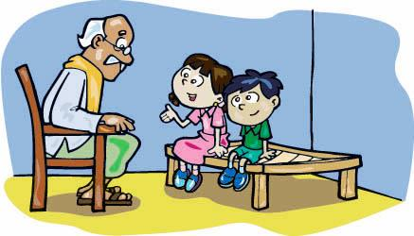
Attention-Getters
Telling a Story
illustrations, personal accounts
keep short and to the point
special experience, heart-stopping ordeal

Slide 20
Attention-Getters
Example 1:
A few weeks ago, my mom an dad had gone out for the evening, and I was alone at home. About 2 a.m. I heard noise by a downstairs window. Even though I hoped that the sounds would go away, they didn’t. As a matter of fact, they got louder. It sounded as if someone were struggling to reach the latch of the window. I was petrified, but somehow I managed to go downstairs. Slowly, I moved the curtain to see what was outside. You can imagine my fear when I saw two eyes looking right back at me! It was a raccoon. The good news is that, in this instance, I was able to deal with my fear. The bad news is that I almost collapsed in the process. What does fear mean and how can we . . .

Slide 21
Link
Comes between the attention-geter and the thesis statement and logically connects the two.
Develops a bridge between the audience and the topic
Objective is to connect with the audience so they are motivated to listen to you

Slide 22
Link
Believe it or not, this is more than a mere attention-getter for my speech. This is taken from an actual ad found in the February edition of Young Miss magazine. (A) My speech for today will deal with one of the words in the last sentence of the ad, old-fashioned; for it is my opinion that, contrary to what is stated in the “Get Him” ad, maybe a sense of old-fashioned tradition is exactly what we need in today’s society. (B) According to William Bennet, former Secretary of Education and noted author, “Increasingly, Americans are lacking a solid grounding in traditional values.” Therefore, I would specifically like to examine some traditional American values . . .
Notes:
“I’m going to let you in on a secret that will change your lives. Girls, for just $10, you can learn what makes a guy fall in love and how to make him want you! The right way to flirt! If you act now, we’ll rush you our best-seler, Secrets of Kissing. You see, it’s all part of hte ‘Get Him System’—G.H.—a no-fail love guide that tells you the truth. No more old-fashioned advice that you already know.”
In the link, A liks to the topic, B links to the audience

Slide 23
The Thesis Statement
Tells the audience exactly what you will be speaking about
Clarifies the overall goal of your speech (inform, persuade, entertain)
States your specific topic

Slide 24
The Thesis Statement
Inform
Today I will inform you about . . .
My goal is to explain . . .
With this informaton, I hope yo will better understand . . .
Persuade
I want to persuade you that . . .
My goal is to convince you that . . .
I believe that each of you should . . .

Slide 25
Preview Statement
One sentence at the end of the intro that gives the audience a overview of th emajor areas that will be discussd in the body (i.e. the three main points)
Helps audience follow structure

Slide 26
Preview Statement

