Slide 1
Early American Literature
Background

Slide 2
Reasons for Coming to America
Escape for war
Escape from Religious persecution
Serious crop failures
Plague – 41,000 people died in London in one year!
Chance to escape from a doomed life for the poor, orphans, and criminals

Slide 3
Life on Board Ship
Imagine standing in a small crowded elevator.
Everyone and everything in it is damp or wet. It smells like dirty gym socks and there area babies crying and mothers wailing
Ship going up and down constantly.
Three people have just thrown up.
All you can hear is moaning and creaking.

Slide 4
Notes:
estimated the size of the Mayflower to have been about 113 feet long from the back rail to the end of the bowsprit beak. The keel was about 64 feet and a board width of about 25 feet.

Slide 5
Life on Board Ship
Mayflower
102 passengers + 30 crew
Space about the size of two classrooms
Nothing to do but sit squashed in a small space
Bullying passengers; Bradford had him thrown overboard!
Hardtack – very hard, guaranteed not to spoil; food full of weevils and maggots

Slide 6
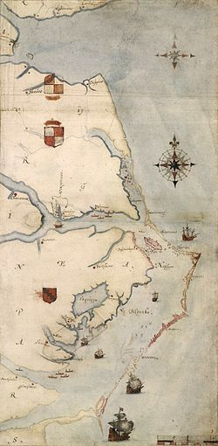
Attempts at Colonization
1585 Roanoke (Virginia Colony)
Notes:
Roanoke privately funded; 120 colonists had disappeared when John White returned from England (he had been delayed because of war with Spain)

Slide 7
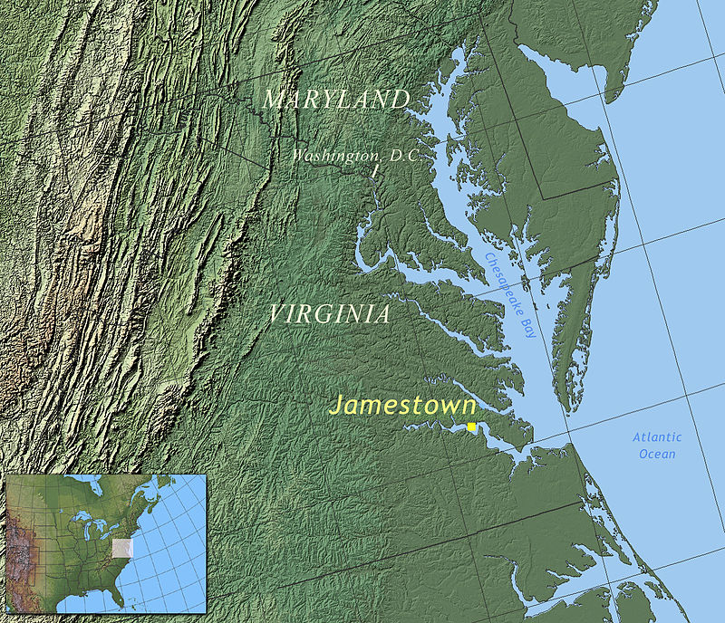
Attempts at Colonization
Notes:
1607

Slide 8
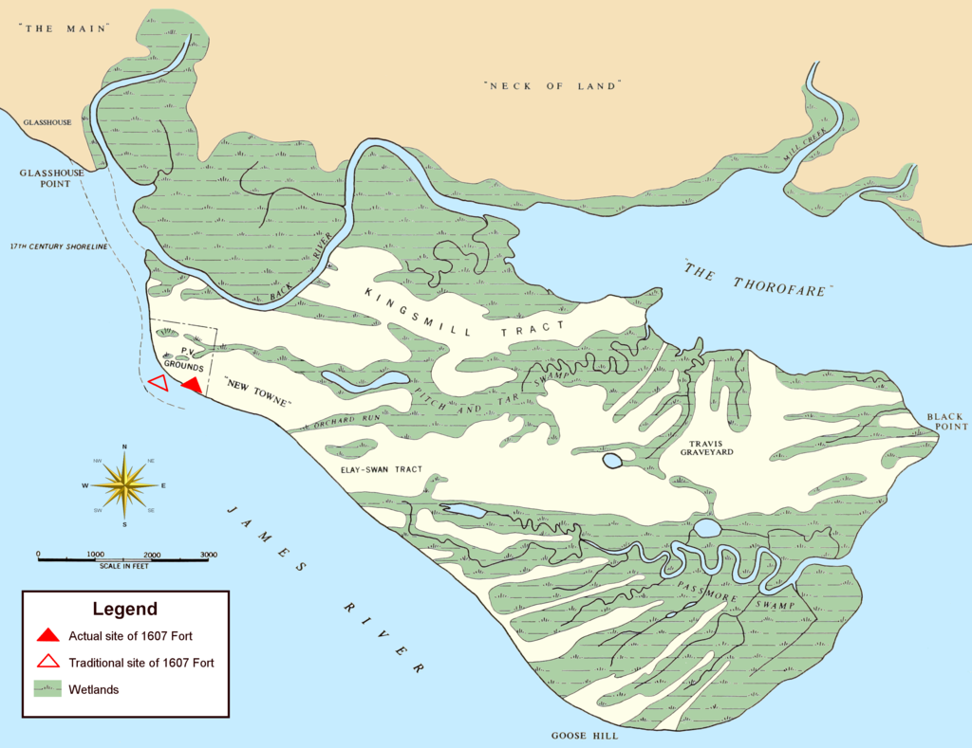
Attempts at Colonization
Attempts at Colonization
Notes:
Jamestown – British Empire’s ‘first’ colony deep-water harbor for big ships, tucked far enough up the James River that it was well-hidden from Spanish soldiers, protected on 3 sides by water and marsh; HOWEVER, foul drinking water, mosquitoes carrying malaria, badly draining soil led to constant outbreaks of diseases like dysentery; winter of 1609-10 called the “starving time” when 80% died so abandoned settlement but new people came back the next year. Finally died out after it ceased to be the capital in 1699; only an archaeological site now

Slide 9
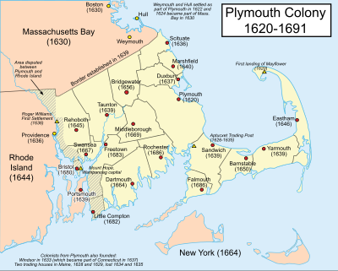
Attempts at Colonization
Attempts at Colonization
Notes:
Plymouth – ended up in the wrong place; historians disagree on why they were in Massachusetts
1) made a mistake, thought they were actually in Virginia, their destination
2) King gave them the land and they wanted to avoid the King’s control so went somewhere else
3) ran out of beer and had to go on land to make more - this according to National Geographic’s actual diary accounts
Mayflower Compact – first example of representational government, modeled on church structure – did this so they could have some type of laws so they could own land, etc.

Slide 10
The History of Plymouth Plantation
William Bradford
Son of a farmer
Member of a church that separated from the Church of England – not treated well by other religions
Became elected governor of the colony after original governor, John Carver died

Slide 11
Literary Terms
Diary – a daily reccord of personal events, thoughts, or feelings
Nonfiction – writing about real people and real events
Genre – a specific type, or kind, of literature
Setting – the time and place in a story
Mood – the feeling that writing creates

