Slide 1
Communication

Slide 2
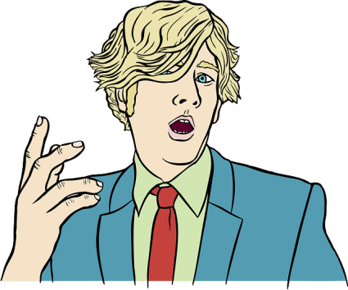
It’s a Process . . .
Message
Receiver
Feedback
Sender

Slide 3
Sender – who transmits a message

Slide 4
Message – words, body language and symbols that convey an idea

Slide 5
Receiver – who intercepts and interprets the message and transmits feedback

Slide 6
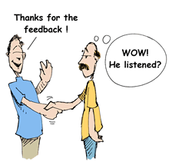
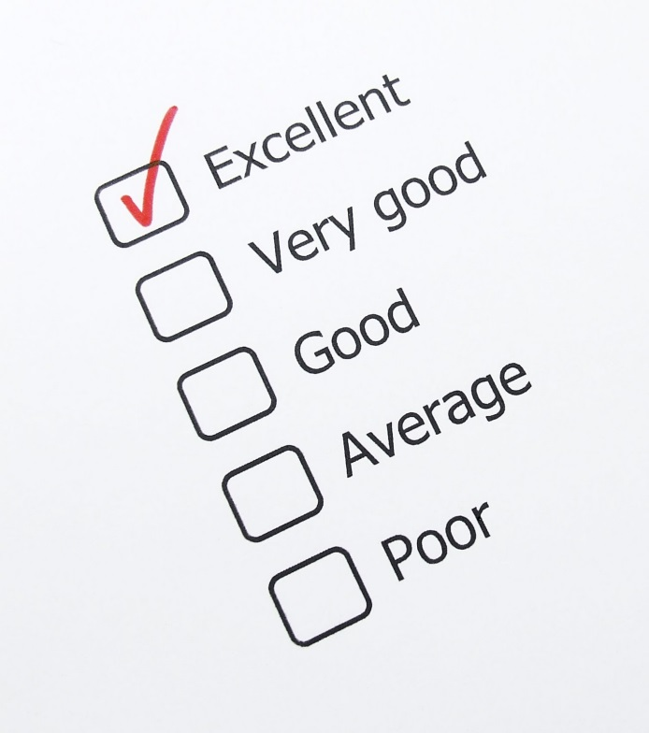
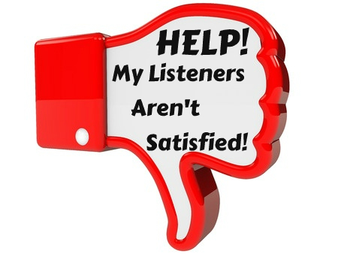
Feedback – words, body language and symbols that respond to the sender’s message

Slide 7
Communication Barriers
any obstacles that get in the way of effective communication
Attitudinal – “I really don’t like what we’re talking about here!”
Social – “This person is not one of my friends!”
Educational – “I’m far too smart to listen to this stuff!”

Slide 8
Communication Barriers
any obstacles that get in the way of effective communication
Cultural – “This person’s heritage isn’t like mine at all!”
Environmental – “I’m too hot in this room to even think!” or “There’s too much noise to concentrate!”

Slide 9
Overcoming Barriers
To the sender:
THINK before you speak (“What is the real message that I want to send?”)
ARTICULATE your words (“Am I enunciating each syllable, or am I slurring my words together?”0
WATCH the receiver of your words to make sure that you are getting the correct nonverbal signals (“She isn’t responding correctly. I had better say this a different way.”)

Slide 10
Overcoming Barriers
To the receiver:
ASK questions; make polite requests. (“Could you turn down the heat, please? I can’t concentrate in a hot room.”)
LEARN more about issues and people. They can both make you smarter. (Say to yourself, “I need to listen. It’s good to hear an opinion or voice other than my own.”)
RELATE to the background and experiences of those speaking. They’re speaking for a reason. It’s worth your time to listen and try to understand their world. (“I should try to understand what they’ve gone through and what message they’re trying to convey.”)

Slide 11
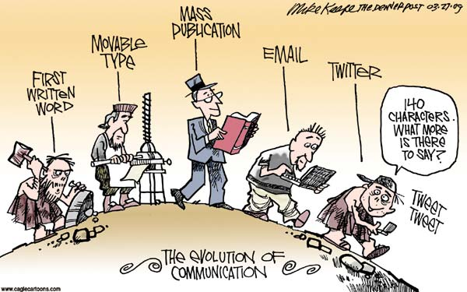
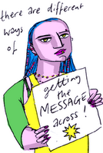
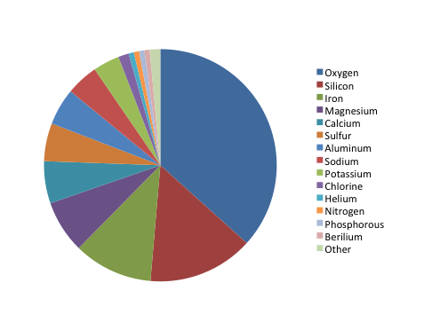
Types of Communication
Written – anything that must be read

Slide 12
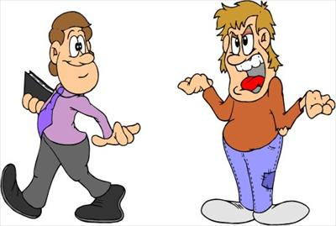
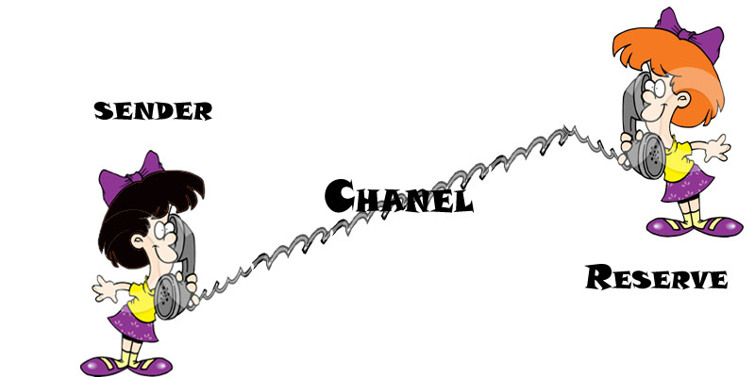
Types of Communication
Verbal – anything that is spoken; oral language

Slide 13
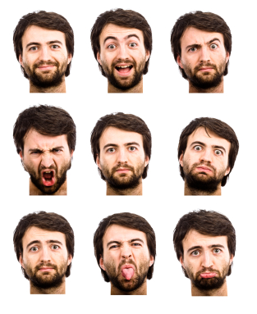
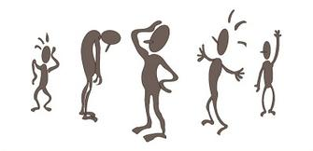
Types of Communication
Nonverbal – messages relayed through facial expressions or body movements; expresses your attitudes or moods about a person, situation, or idea

Slide 14
Types of Communication
Symbols – anything that stands for an idea and is used for communication; they represent something else by association and include both nonverbal and verbal communication

Slide 15
Rhetoric
the 3 major methods for appealing to an audience
Logical – known as LOGOS – provides the audience both sequence and analysis; organization and factual evidence to prove a point

Slide 16
Rhetoric
the 3 major methods for appealing to an audience
Emotional – known as PATHOS – appealing to the audience’s sense of patriotism, family, or justice; an appeal to emotions, values, desires, and hopes, or fears and prejudices

Slide 17
Rhetoric
the 3 major methods for appealing to an audience
Ethical – known as ETHOS – appeals to speaker’s honesty, knowing right from wrong, no-compromise approach to values

Slide 18
Examples of Rhetoric
Commercial examples
Number your paper from 1 to 13.
Identify the type of Rhetoric each commercial uses to sell their product. Some may use more than one type. Briefly explain your reasoning.

Slide 19
Your Turn!
Find your own (school appropriate) commercial examples of ETHOS, LOGOS, and PATHOS. You should have one commercial for each of the 3 types. 5 pts each
Create a YouTube channel titled ETHOS, LOGOS, PATHOS to share your videos. In the comment section, identify which rhetorical device each commercial uses, citing specific examples. 5 pts for each rhetorical device; 5 pts examples

